Slide 1
Workflow Demonstration on new Architecture
By Kirti

Slide 2
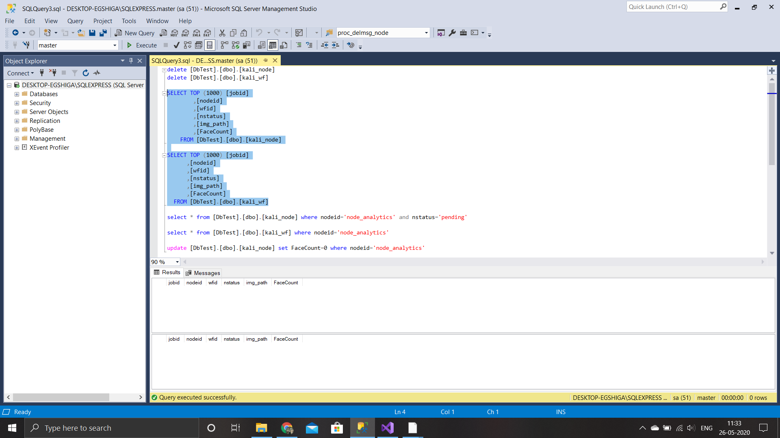
Initially both node and workflow databases are empty

Slide 3
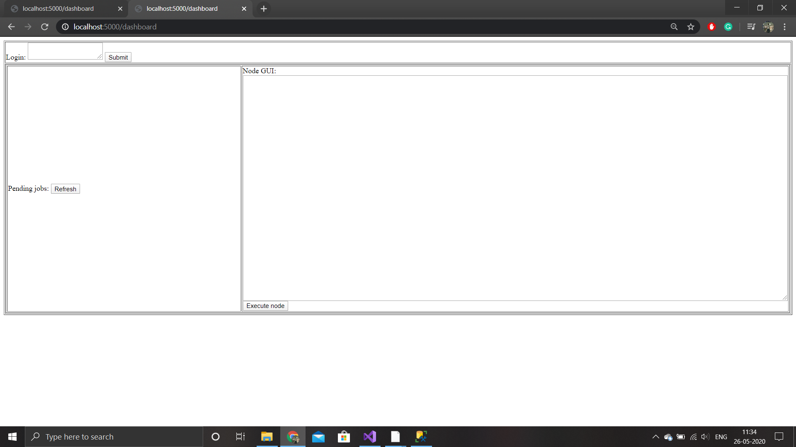
Node GUI

Slide 4

Node_camera done processing

Slide 5
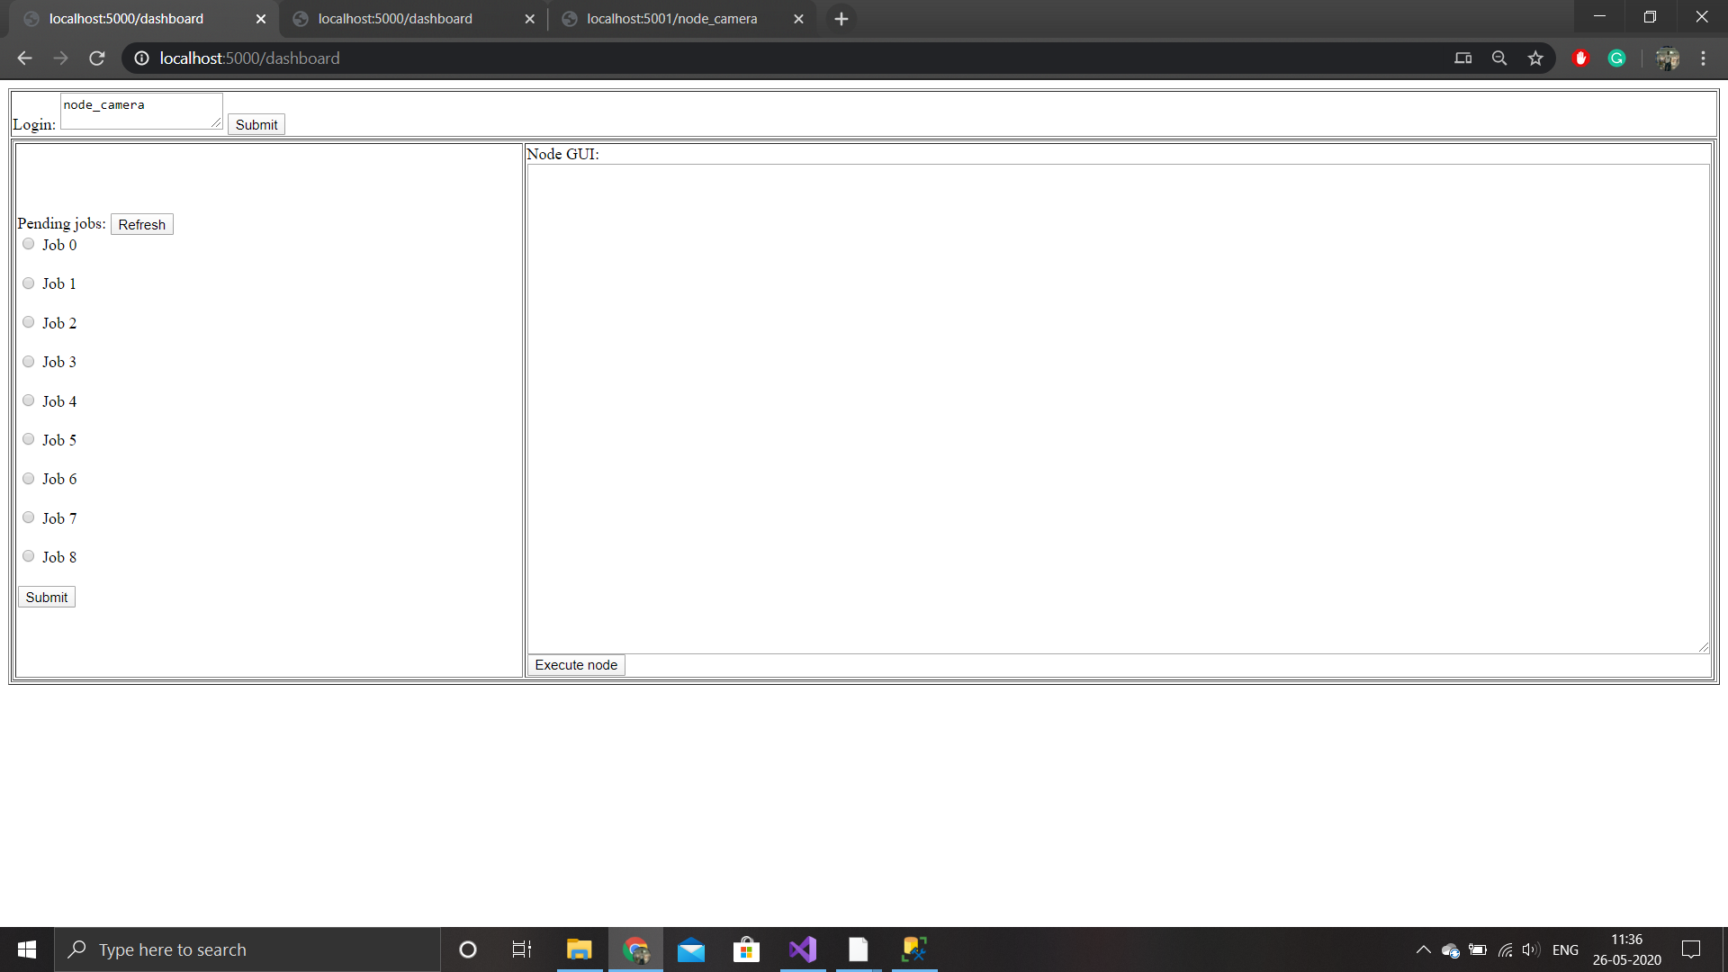
1) Pending Jobs in node_camera dashboard.
2) I will select Job 1, Job 2, Job 4 for preocessing

Slide 6
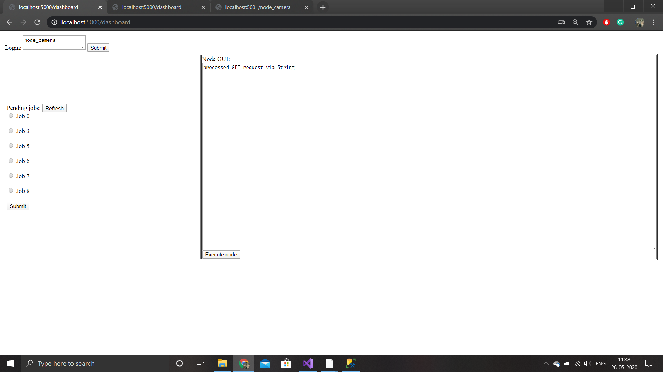
Thsese Jobs removed from node_camera GUI and stoded in workflow database

Slide 7

Workflow is processed.
2) Here there will be transition of node_camera->node_analytics

Slide 8
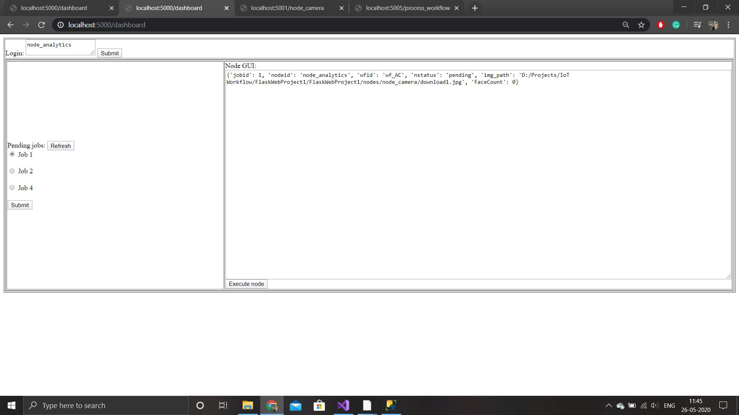
These Jobs are in pending state in node_analytics GUI.
I will process node_analytics to get their count faces

Slide 9

Node_analytics done processing

Slide 10
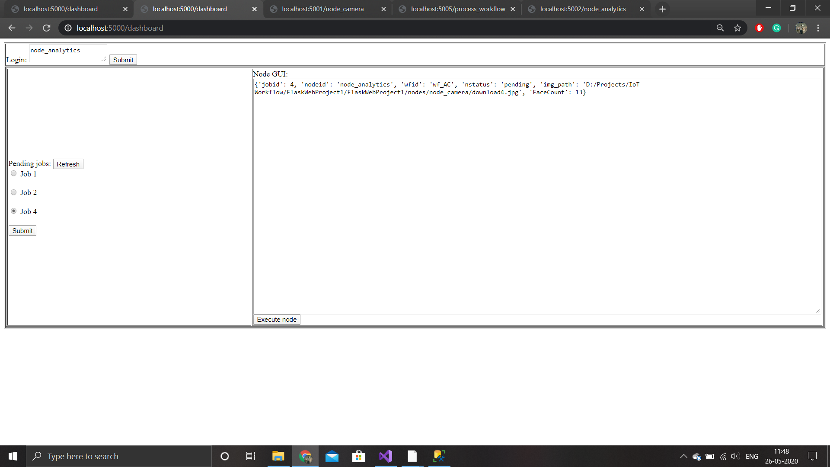
1) Here I got the count faces after node_analytics node done it’s processing.
2) I will select all 3 jobs for workflow processing

Slide 11

Workflow done it’s processing

Slide 12
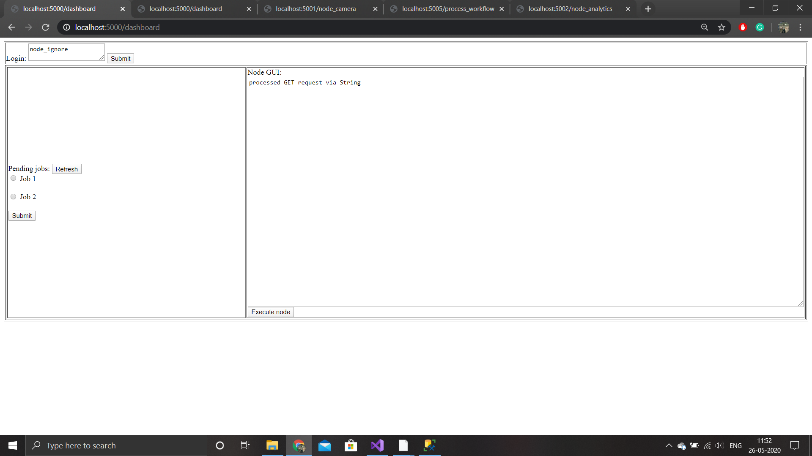
2 Jobs in node_ignore

Slide 13
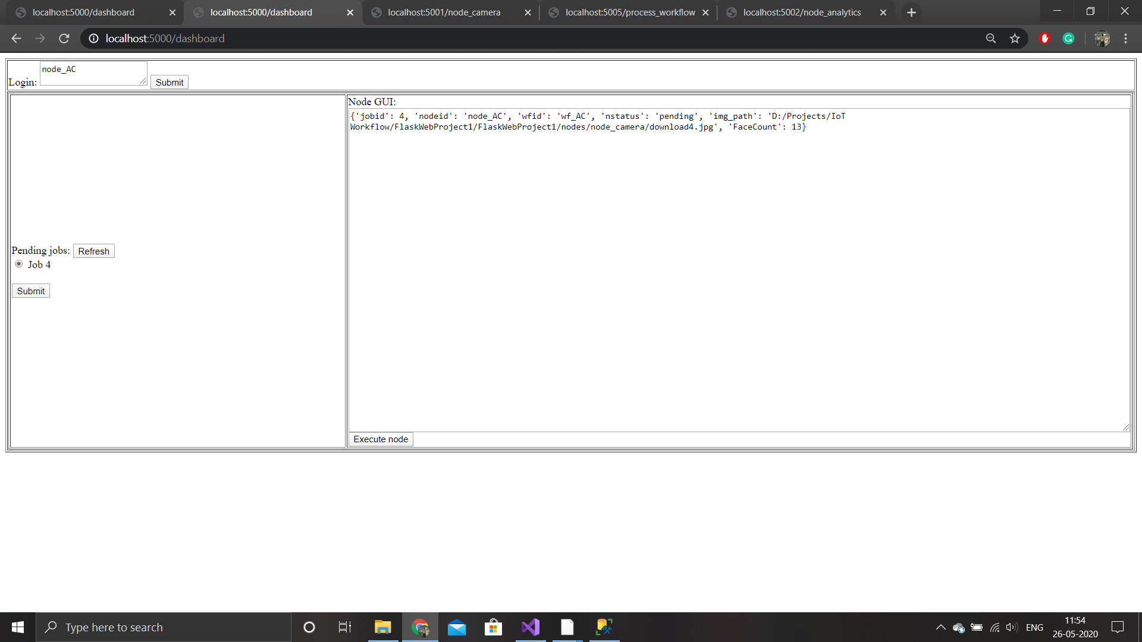
One job in node_AC

Slide 14

Node_AC done processing

Slide 15
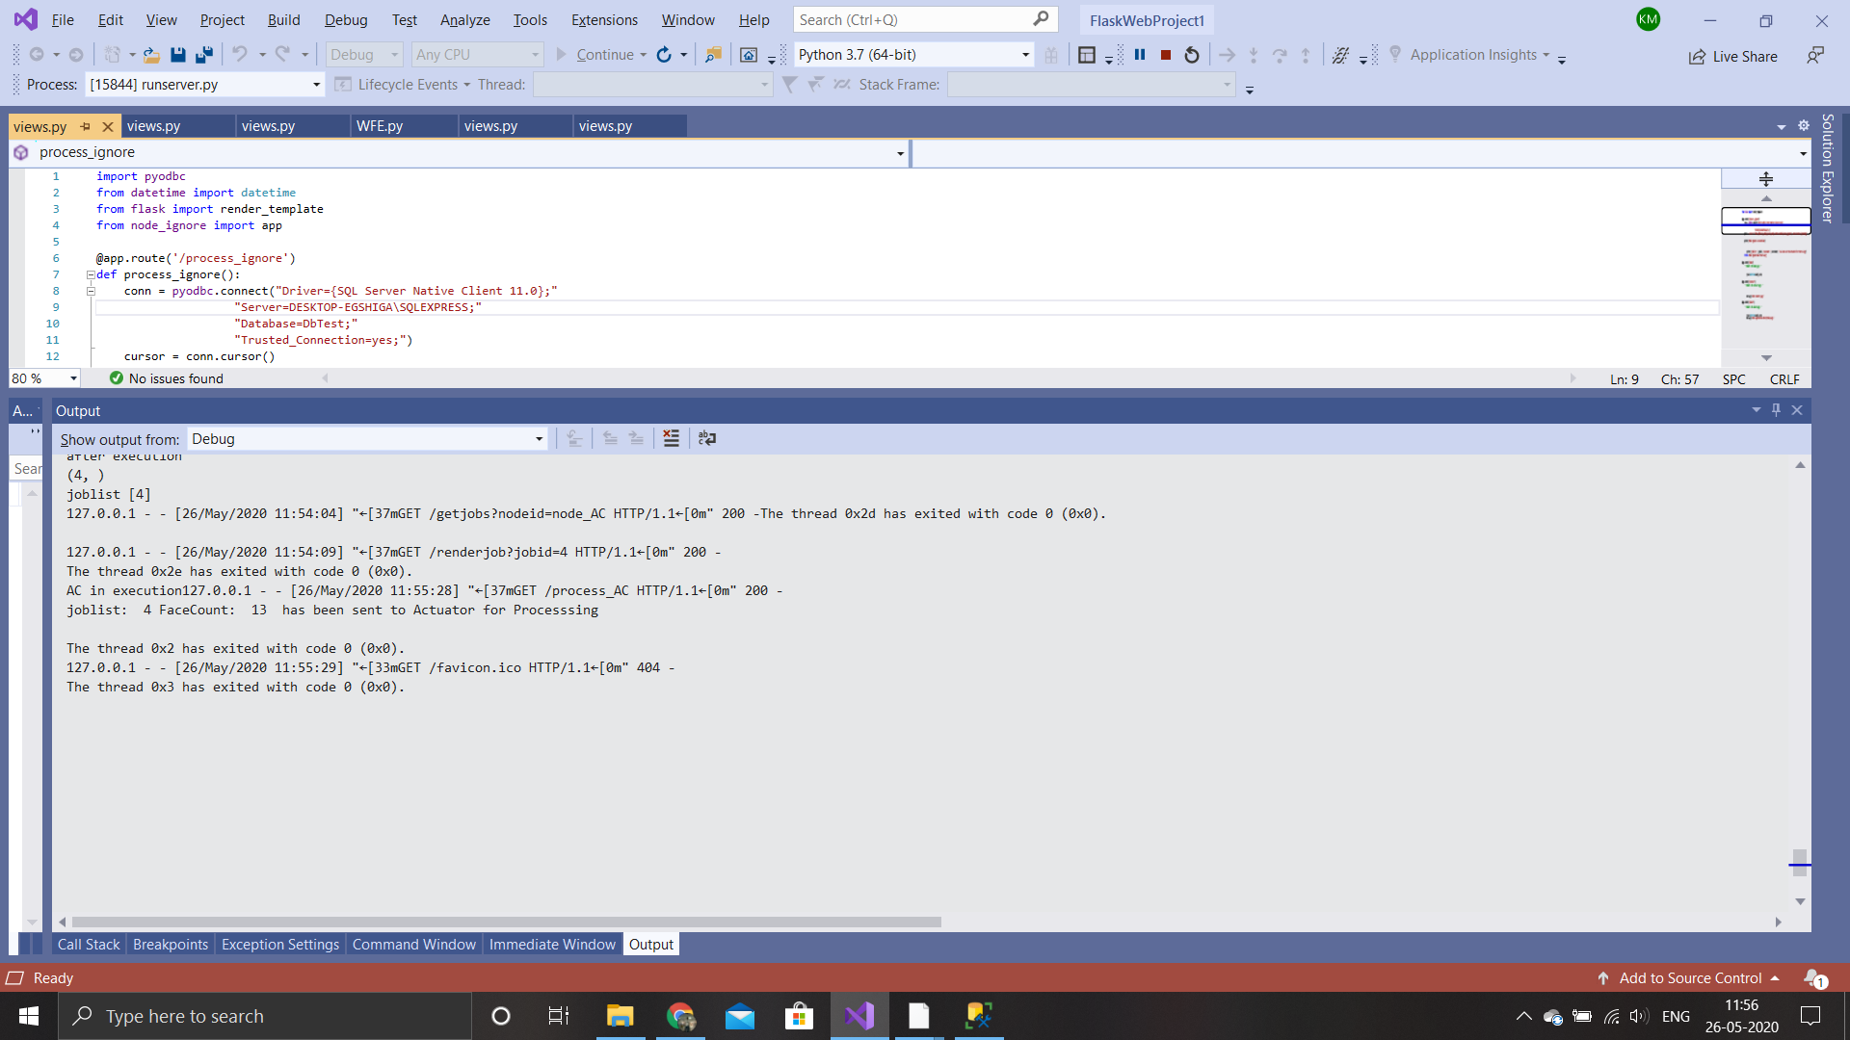
IoT messsage would be sent to Actuator from here to turn ON AC

Slide 16

Node_ignore done processing

Slide 17
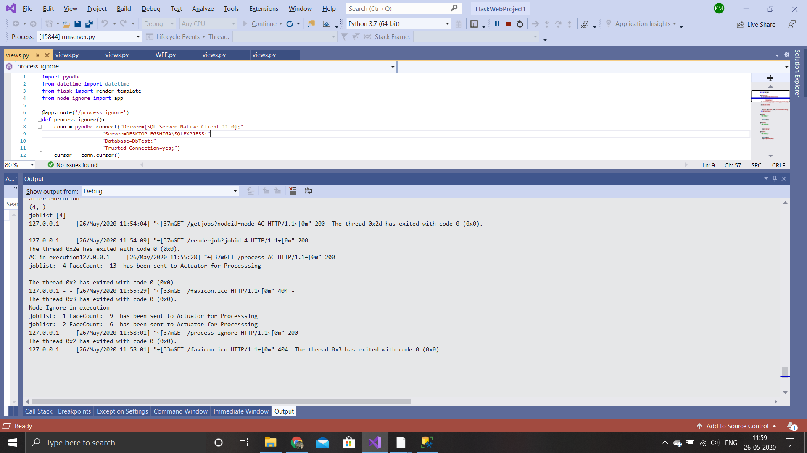
IoT messsage would be sent to Actuator from here to turn OFF AC

